Slide 1
HTTP – HyperText Transfer Protocol

Slide 2
HTML forms
html forms are usefull for getting different kinds of user input and sending this input to the web server
html forms are introduced by the <form> tag
syntax of <form>:
<form attribute=“value” ..>
… text content …
… input elements …
</form>
input elements are described using the <input> tag

Slide 3
<form> attributes
action=URL : specifies where the form-data will be sent when the form is submitted
accept=MIME type : specifies the types of files that can be submitted through a file upload
accept-charset=charset : specifies the character-set the serer can handle for form-data
enctype=application/x-www-form-urlencoded, multipart/form-data, text/plain : specifies how form data should be encoded before sending it to the web server
method=get (form-data is sent to the web server in the header of the HTTP request), post (form-data is sent to the web server in the body of the HTTP request) : specifies how to send form-data
name=string : the name of the form

Slide 4
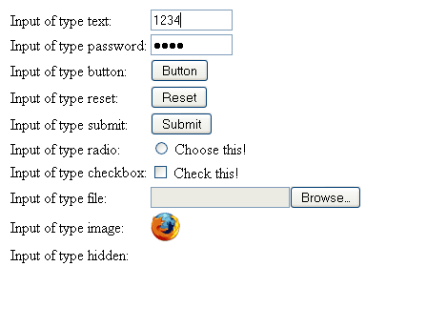
Types of user input
<input type=“…”>

Slide 5
The <input> tag
is useful for selecting user information
receives input in various types
has no end tag </input> in Html
attributes:
  accept=MIME_type : for type=“file” only specifies types of files that can be submitted through a file upload
  alt=text : for type=“image” only specifies an alternate text for an image input
  checked=checked : for type=“checkbox | radio” specifies if the input should be preselected when the page loads
  disabled=disabled : specifies the input should be disabled when the page loads
  maxlength=number : for type=“text | password” specifies the maximum length in characters of the input field
  name=text : specifies the name of input element
  readonly=readonly : for type=“text | password” specifies the input field should be read-only
  size=number : the width of the input field
  src=URL : the URL of an image to display as a submit button
  type=button,checkbox,file,hidden,image,password,radio,reset,submit,text
  value=text : value of the input element

Slide 6
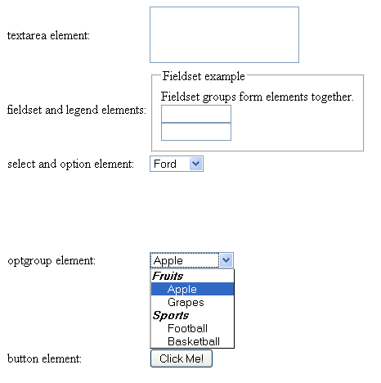
Other tags useful in <form>s

Slide 7
<textarea>
defines a multi-line text input control
can hold an unlimited no. of characters
text is rendered in fixed-width font (usually courier)
attributes:
  cols=number : visible number of columns in a textarea (required attribute)
  rows=number : visible numbers of rows in a textarea (required attribute)
  disabled=disabled : textarea is disabled
  readonly=readonly : textarea is readonly
  name=text : name of the textarea element
Ex.: <textarea rows=“2” cols=“20”>
This is a text area..
</textarea>

Slide 8
<label> and <button>
<label> does not render anything; defines a label for an input element; it toggles the control if the user clicks the text within the label
<button> defines a push button; it can contain inside text or images (difference from <input type=“button”>)
attributes for <button>:
  disabled=disabled : button is disabled
  name=text : name of the button
  type=button | reset | submit : type of the button
  value=text : value of the button
Ex.: <button type=“button”>Click me!</button>

Slide 9
<legend>,<fieldset> and <optgroup>
<legend> defines a caption for a <fieldset> element
<fieldset> groups together form elements; it draws a box around them
Ex.: <fieldset>
  <legend>Some caption</legend>
  <input type=”text”><br>
  <input type=”text”>
  </fieldset>
<optgroup> groups together related options in a select list
Ex.: <select>
<optgroup label="Fruits">
<option value="apple">Apple</option>
<option value="grapes">Grapes</option>
</optgroup>
<optgroup label="Sports">
<option value="football">Football</option>
<option value="basketball">Basketball</option>
</optgroup>
</select>

Slide 10
<select> and <option>
<select> and <option> are useful for creating a drop-down list
Ex.:<select>
<option value="ford">Ford</option>
<option value="ferrari">Ferrari</option>
<option value="bmw">BMW</option>
</select>
attributes of select:
  disabled=disabled : list is disabled
  multiple=multiple : multiple selections are possible
  name=text : name of the element
  size=number : no. of visible options in the list
attributes of option:
  disabled=disabled : this option is disabled
  selected=selected : this option is selected by default
  value=text : value that will be sent to the server when the form is submitted

Slide 11
Sets of characters in HTML
Most browsers support:
ASCII character set
(see http://www.w3schools.com/tags/ref_ascii.asp)
ISO-8859-1 character set
(see http://www.w3schools.com/tags/ref_charactersets.asp)
Math, greek and other symbols
(see http://www.w3schools.com/tags/ref_symbols.asp)

Slide 12
URL – Uniform Resource Locator
an URL identifies a resource in the WWW
URLs are a subset of URIs (Uniform Resource Identifiers); URL=URI that provides the location for a resource
general form of a URL:
resource_type://domain:port/filepathname?querystring#anchor
  resource_type : the scheme name (protocol) which defines the namespace, syntax and remaining part of URL
  domain : registered domain name or IP address of location (case-insensitive)
  port : port number (optional, default for scheme is used)
  filepathname : path to the resource/file on the server (usually case-sensitive)
  querystring : data submitted to the server through forms
  anchor : a specific location inside that document

Slide 13
URL examples
http://www.google.com
ftp://ftp.opensuse.com/dist/11.1/
https://www.cs.ubbcluj.ro/~forest/HtmlFolder/ac/index.html
http://www.google.com/firefox?client=firefox-a&rls=org.mozilla:en-US:official
http://cs.ubbcluj.ro/index.php?view=2&size=default
http://www.java.sun.com/index.html#j2me

Slide 14
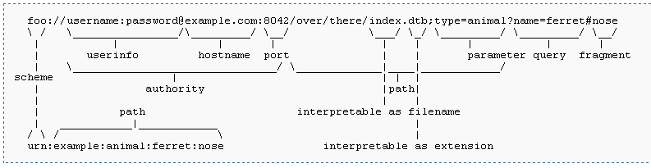
URI – Uniform Resource Identifier

Slide 15

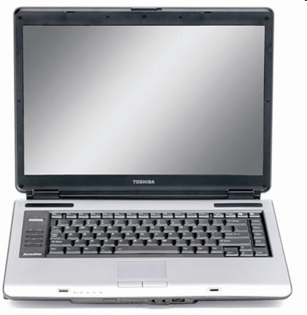

Web communication
Get http://www.google.com/index.html
HTTP Request:
Internet
HTTP Reply
Web server: apache on www.google.com
Client: browser (Firefox) on local computer

Slide 16
HTTP – HyperText Transfer Protocol
together with HTML forms the base of WWW
is standardized by IETF (rfc 2616)
is a request-response protocol
it is stateless (does not maintain a state of a session) and asynchronous (an html document is loaded asynchronous by the browser, as soon as parts of it are available)
latest version is HTTP/1.1
runs on top of TCP on the standardized port 80

Slide 17
HTTP Request
has the form:
Request-Method SP Request-URL SP HTTP-Version <CR><LF>
(generic-header | request-header | entity-header <CR><LF>)
<CR><LF>
[message body]
Request-Method is:
  GET – request whatever information is identified by the Request-URL
  POST – request that server accepts the entity enclosed in the request
  OPTIONS - request for information about communication options
  PUT – request that the enclosed entity be stored under the Request-URL
  DELETE – request that the server delete the resource identified by Request-URL
  TRACE – invoke a remote, application-layer loopback of the request message
  CONNECT – used by proxies in SSL connections
  HEAD – identical to GET, but server must not return a message body in response

Slide 18
HTTP Request (2)
Request-header can have the following fields (selection):
  Accept : MIME types of resources accepted by browser
  Accept-Charset : charset accepted by browser
  Accept-Encoding : encoding accepted by browser
  Accept-Language : language accepted by browser
  Authorization : user-agent wishes to authenticate itself with a server
  Host : the host Request-URL points to
  Referer : the URL of document refering this URL
  User-Agent : Firefox, Safari, IE

Slide 19
HTTP Response
has the form:
Http-Version SP Status-Code SP Reason-Phrase<CR><LF>
(generic-header | response-header | entity-header <CR><LF>)
<CR><LF>
[message body]
Response-header has the following fields (selection):
  Accept-Ranges : server indicates its acceptance of range requests for resource
  Age : sender’s estimate of the amount of time since the response was generated by server
  Location : redirect the client to a location other than Request-URL for completion of the request
  Retry-After : indicate to client how long the service is expected to be unavailable
  Server : information about software used by the server to handle the request

Slide 20
HTTP Request example
Get http://www.google.com HTTP/1.1
Host: www.google.com
User-Agent: Mozilla/5.0 (Windows; U; Windows NT 5.1; en-US; rv:1.9.1.3) Gecko/20090824 Firefox/3.5.3 (.NET CLR 3.5.30729)
Accept: text/html,application/xhtml+xml,application/xml;q=0.9,*/*;q=0.8
Accept-Language: en-us,en;q=0.5
Accept-Encoding: gzip,deflate
Accept-Charset: ISO-8859-1,utf-8;q=0.7,*;q=0.7
Keep-Alive: 300
Connection: keep-alive
Cookie:PREF=ID=141ca2d4581746b4:U=f22e9e94ccc4a56f:FF=4:LD=en:NR=10:CR=2:TM=1249567334:LM=1251146058:GM=1:S=qWowBrte7hrXniGp; NID=27=n9Khexo85YHnovw93wK4qC2lZtGa1DnzVQEB6iul9tn62fsJ7gFuMVK252ceLCD3iS54r-nHD6kWDdD1JP77akDhMl0EWzoTbPt3cM5g8mapG9SskdRSyEyLWcJK1LrX
Cache-Control: max-age=0

Slide 21
HTTP Response example
HTTP/1.1 200 OK
Date: Tue, 13 Oct 2009 05:27:42 GMT
Expires: -1
Cache-Control: private, max-age=0
Content-Type: text/html; charset=UTF-8
Content-Encoding: gzip
Server: gws
Content-Length: 3667
X-XSS-Protection: 0

Slide 22
Mozilla Firebug
see more …

